Slide 1

Chris Woodruff
EF CORE
TURBO CHARGING FOR PERFORMANCE

Slide 2

Chris Woodruff
linkedin.com/in/chriswoodruff/
https://woodruff.dev
cwoodruff@live.com
https://bsky.app/profile/woodruff.dev

Slide 3




Looking at EF Core for Perf
Agenda
Looking at .NET for Perf
Questions & Answers

Slide 4






WHAT IS ENTITY FRAMEWORK CORE?
Where did it come from?
100% OPEN SOURCE
CROSS-PLATFORM
PERFORMANCE

Slide 5
DBCONTEXT POOLING
DI Container
public class BlogsController : Controller
{
private BlogContext _context;
public BlogsController(BlogContext context)
{
_context = context;
}
public IActionResult Index()
{
return _context.Blogs.ToList();
}
}
Request: /blogs/index
Scope
BlogContext
Blogs
Controller
Request: /blogs/index
Scope
BlogContext
Blogs
Controller
Request: /blogs/index
Scope
BlogContext
Blogs
Controller

Slide 6
DBCONTEXT POOLING
DI Container
public class BlogsController : Controller
{
private BlogContext _context;
public BlogsController(BlogContext context)
{
_context = context;
}
public IActionResult Index()
{
return _context.Blogs.ToList();
}
}
Request: /blogs/index
Context Pool
Scope
BlogContext
BlogContext
Scope
Blogs
Controller
BlogContext
BlogContext
BlogContext
Request: /blogs/index
BlogContext
BlogContext
Blogs
Controller
Scope
Request: /blogs/index
Scope
BlogContext
Blogs
Controller

Slide 7
DBCONTEXT POOLING
Method | NumBlogs | Mean | Error | StdDev | Gen 0 | Gen 1 | Gen 2 | Allocated
WithoutContextPooling | 1 | 701.6 us | 26.62 us | 78.48 us | 11.7188 | - | - | 50.38 KB
WithContextPooling | 1 | 350.1 us | 6.80 us | 14.64 us | 0.9766 | - | - | 4.63 KB

Slide 8
COMPILED QUERIES
var explicitQuery = EF.CompileQuery((ChinookContext context, int id)
=> _context.Albums.FirstOrDefault(a => a.Id == id));
var compiledExplicitQuery =
EF.CompileAsyncQuery((ChinookContext context, int id)
=> context.Albums.FirstOrDefault(a => a.Id == id));

Slide 9
COMPILED MODELS
dotnet ef dbcontext optimize --output-dir ChinookModels --namespace ChinookModels
protected override void OnConfiguring(DbContextOptionsBuilder optionsBuilder)
=> optionsBuilder
.UseModel(ChinookModels.AlbumsContextModel.Instance)
.UseSqServer(“<ConnectionString>");
Things to remember”
Global Query Filters not supported
Lazy-loading and Change-Tracking proxies not supported
You must regenerate the compiled modal each time the code
for the dbcontext changes

Slide 10
FROMSQL
var city = "Redmond";
using (var context = CreateContext())
{
context.Customers.FromSql($@“
SELECT *
FROM Customers
WHERE City = {city}");
}
SELECT *
FROM Customers
WHERE City = @p0
SELECT *
FROM Customers
WHERE City = ‘Redmond’

Slide 11
QUERY PROJECTION
SELECT *
FROM [dbo].[Employee]
SELECT [Id]
,[LastName]
,[FirstName]
,[Title]
,[ReportsTo]
,[BirthDate]
,[HireDate]
,[Address]
,[City]
,[State]
,[Country]
,[PostalCode]
,[Phone]
,[Fax]
,[Email]
FROM [dbo].[Employee]

Slide 12
QUERY PROJECTION
SELECT *
FROM [dbo].[Employee]
SELECT [Id]
,[LastName]
,[FirstName]
,[Title]
,[Address]
,[City]
,[State]
,[Country]
,[PostalCode]
,[Phone]
,[Fax]
,[Email]
FROM [dbo].[Employee]

Slide 13
QUERY PROJECTION
from e in Employees select e
from e in Employees select new { e.Id, e.LastName, e.FirstName, FullName = e.FirstName + " " + e.LastName, e.Title, e.Address, e.City, e.State, e.Country, e.PostalCode, e.Phone, e.Fax, e.Email }

Slide 14
NO TRACKING
var albums = db.Albums .AsNoTracking() .ToList();

Slide 15
NO TRACKING
protected override void OnConfiguring(DbContextOptionsBuilder optionsBuilder)
{
optionsBuilder
.UseSqlServer(ConnectionString)
.UseQueryTrackingBehavior(QueryTrackingBehavior.NoTracking);
}

Slide 16
IDENTITY RESOLUTION
var albums = db.Albums .AsNoTrackingWithIdentityResolution() .ToList();

Slide 17
EAGER LOADING
var thisYearFirstDay = new DateTime(DateTime.Now.Year, 1, 1);
var thisYearInvoices = context.Invoices .Include(i => i.Customer) .Where(i => i.InvoiceDate > thisYearFirstDay);

Slide 18
THE PROBLEM WITH LAZY LOADING
var thisYearFirstDay = new DateTime(DateTime.Now.Year, 1, 1);
var thisYearInvoices = context.Invoices
.Where(i => i. InvoiceDate > thisYearFirstDay);
foreach (var invoice in thisYearInvoices)
{
Console.WriteLine($"{invoice.Id} {invoice.InvoiceDate} {invoice.Customer.Company}");
}

Slide 19
STORED PROCS
public Artist GetById(int id)
{
var artists = context.Artists
.FromSql($“dbo.sproc_GetArtistDetails {id}")
.ToList();
return artists.FirstOrDefault();
}

Slide 20
GLOBAL QUERY FILTERS
modelBuilder.Entity<Album>().HasQueryFilter(p => !p.IsOutOfStock);
var albums = context.Albums.Include(a => a.Tracks)
.Where(a => a.ArtistId == id);
// Hide invoices older than 14 years
modelBuilder.Entity<Invoice>().
.HasQueryFilter(i => i.InvoiceDate > DateTime.Now.AddYears(-14));
var invoices = context.Invoices.Include(i => i.InvoiceLines)
.Where(i => i.CustomerId == id);

Slide 21

.NET

Slide 22
CODE CORRECTLY
private readonly ChinookDbContext _context;
var albumsData = _context.Albums;
for (int i = 0; i < albumsData.Count(); i++)
{
_Response.Items.Add(new Models.Items
{
Name = albumsData.ToList()[i].Name,
....
Created = (DateTime) albumsData.ToList()[i].Created,
Updated = (DateTime) albumsData.ToList()[i].Updated
});
}

Slide 23
CODE CORRECTLY
private readonly ChinookDbContext _context;
var albumsData = _context.Albums.ToList();
foreach (var album in albumsData)
{
_Response.Albums.Add(new Models.Items
{
Name = album.Name,
....
Created = (DateTime)album.Created,
Updated = (DateTime) album.Updated
});
}

Slide 24

Other Things to Remember

Slide 25
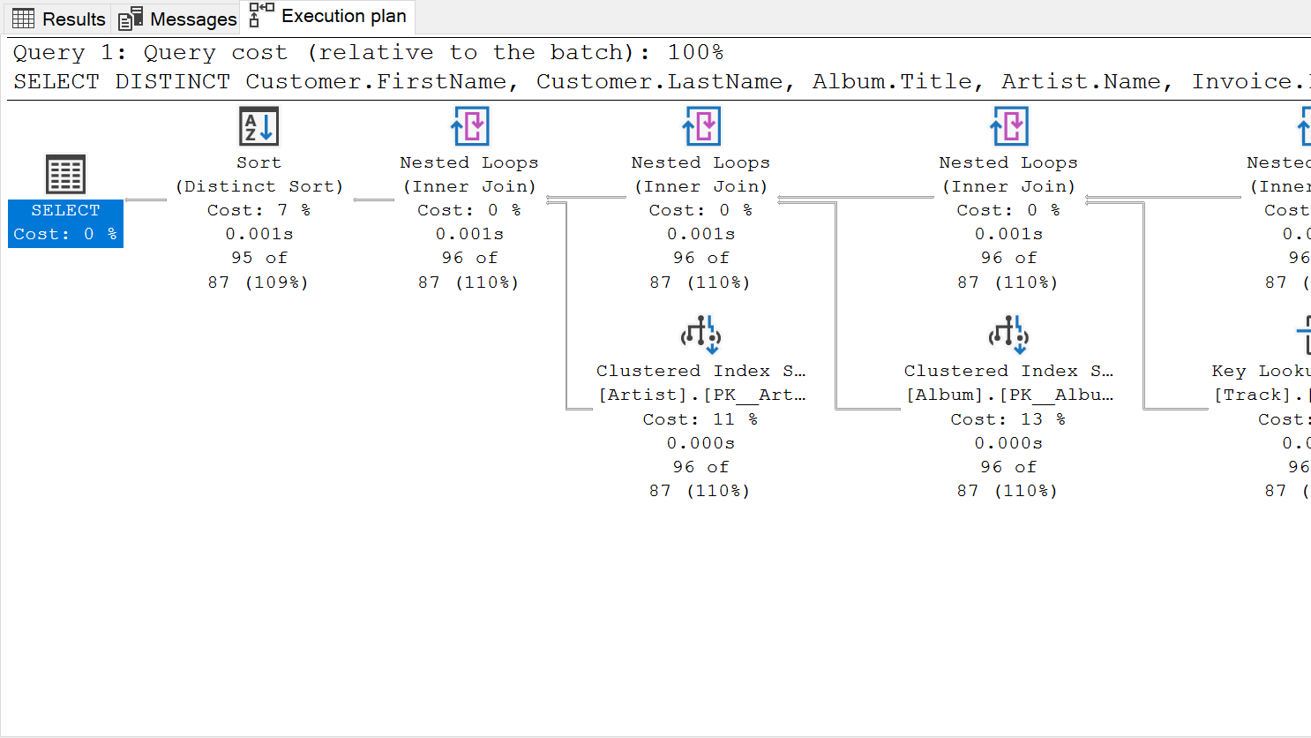
Detective Tip #1 – understand query Plans

Slide 26
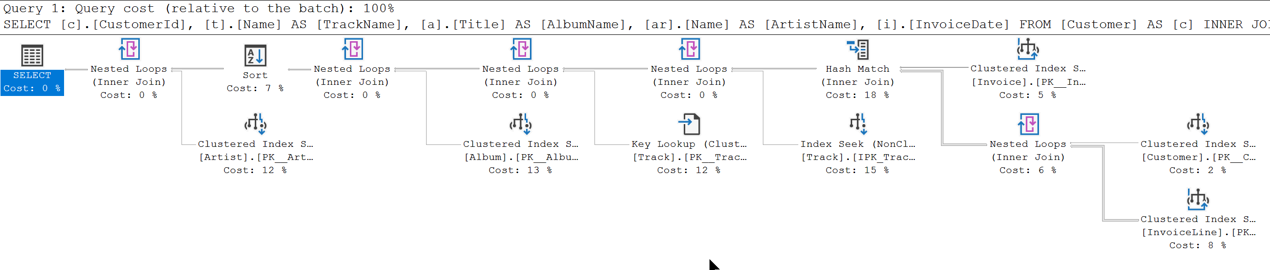
SELECT c.CustomerId, t.Name AS TrackName, a.Title AS AlbumName, ar.Name AS ArtistName, i.InvoiceDate
FROM Customer AS c
INNER JOIN Invoice AS i ON c.CustomerId = i.CustomerId
INNER JOIN InvoiceLine AS il ON i.InvoiceId = il.InvoiceId
INNER JOIN Track AS t ON il.TrackId = t.TrackId
INNER JOIN Album AS a ON t.AlbumId = a.AlbumId
INNER JOIN Artist AS ar ON a.ArtistId = ar.ArtistId
WHERE c.CustomerId = 2
ORDER BY AlbumName

Slide 27
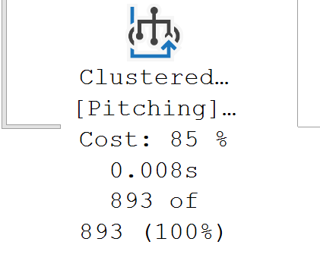
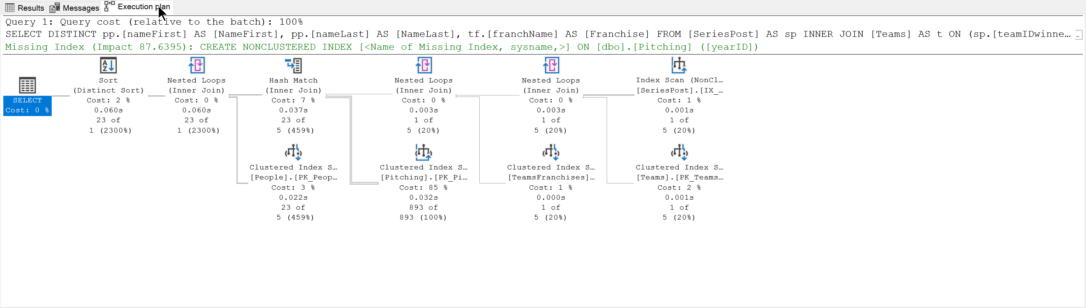
SELECT DISTINCT pp.[nameFirst] AS [NameFirst], pp.[nameLast] AS [NameLast], tf.[franchName] AS [Franchise]
FROM [SeriesPost] AS sp
INNER JOIN [Teams] AS t
ON (sp.[teamIDwinner] = t.[teamID]) AND (sp.[lgIDwinner] = t.[lgID]) AND (sp.[yearID] = t.[yearID])
INNER JOIN [TeamsFranchises] AS tf
ON t.[franchID] = tf.[franchID]
INNER JOIN [Pitching] AS p
ON (t.[teamID] = p.[teamID]) AND (t.[lgID] = p.[lgID]) AND (t.[yearID] = p.[yearID])
INNER JOIN [People] AS pp
ON p.[playerID] = pp.[playerID]
WHERE (sp.[round] = 'WS') AND (sp.[yearID] = 2018)

Slide 28
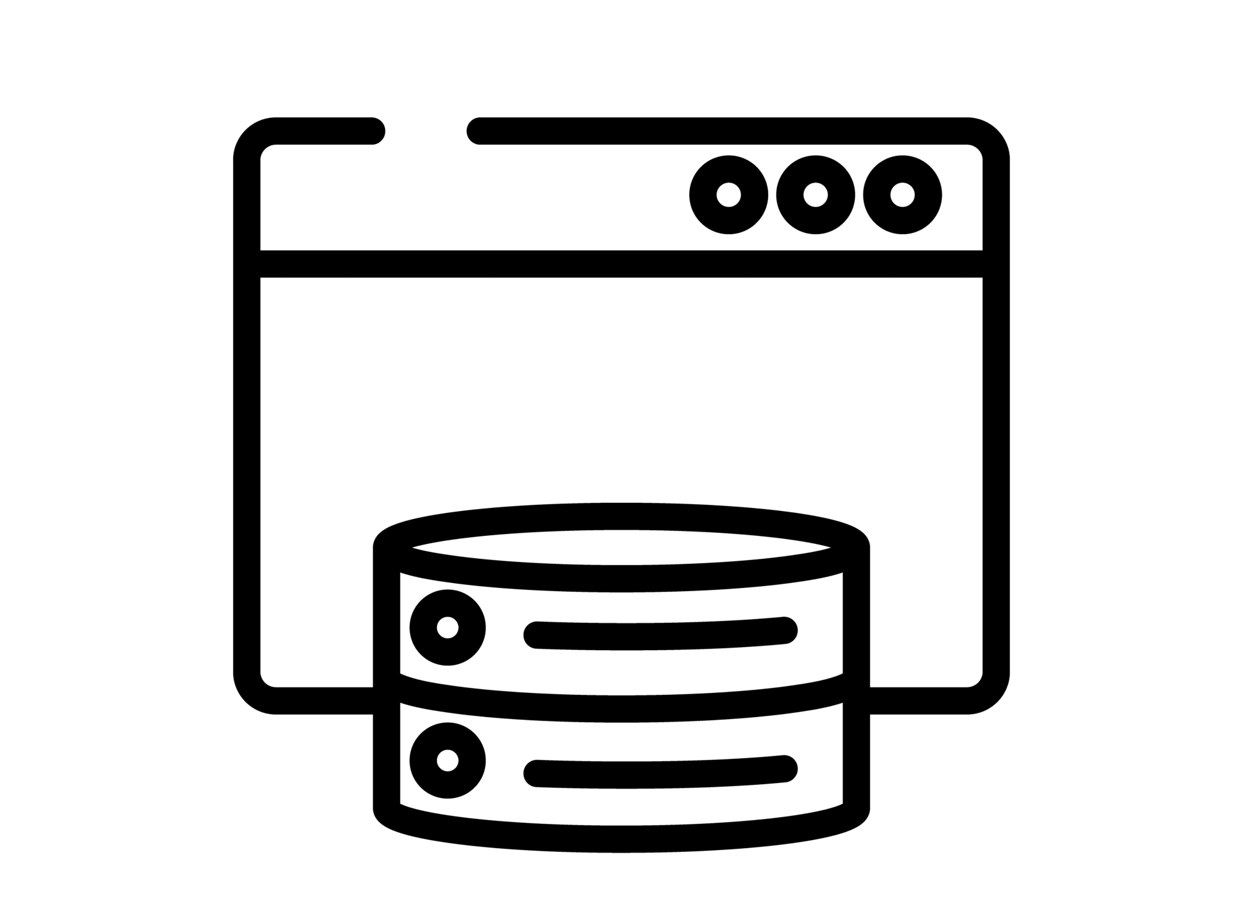
CACHING
Response Caching
In-Memory Caching
Distributed Caching

Slide 29
RESPONSE CACHING
Directs Caching on the consumer side
HTTP 1.1 Caching specification
Install the NuGet package:
Microsoft.Extensions.Caching.Abstractions
At start up add to Services:
services.AddResponseCaching();

Slide 30
RESPONSE CACHING
Attribute on Controller or Action
[ResponseCache(Duration = 60)]
Response Header:
Cache-Control: public,max-age=60
[ResponseCache(Location = ResponseCacheLocation.None, NoStore = true)]
Response Header:
Cache-Control: no-store,no-cache
Pragma: no-cache

Slide 31
IN-MEMORY CACHING
Install the NuGet package:
Microsoft.Extensions.Caching.Abstractions
At start up add to Services:
services.AddMemoryCache();

Slide 32
IN-MEMORY CACHING
var cache = services.GetService<IMemoryCache>();
cache.Set("key", "value", TimeSpan.FromMinutes(10));
var value = cache.Get<string>("key");

Slide 33
OUTPUT CACHING
services.AddOutputCache(options => { options.AddBasePolicy(builder => builder.Expire(TimeSpan.FromSeconds(10))); options.AddPolicy("Expire20", builder => builder.Expire(TimeSpan.FromSeconds(20))); options.AddPolicy("Expire30", builder => builder.Expire(TimeSpan.FromSeconds(30))); });
[HttpGet] [OutputCache] [Produces(typeof(List<AlbumApiModel>))] public async Task<ActionResult<List<AlbumApiModel>>> Get()

Slide 34
OUTPUT CACHING RULES
Only HTTP 200 responses are cached.
Only HTTP GET or HEAD requests are cached.
Responses that set cookies aren't cached.
Responses to authenticated requests aren't cached.

Slide 35
DISTRIBUTED CACHING
Local Redis Cache
SQL Server Cache
Azure Redis Cache
Amazon ElastiCache
Google Cloud Memcache

Slide 36

http://learn.microsoft.com/en-us/ef/core/
devblogs.microsoft.com/dotnet/tag/entity-framework/
https://www.youtube.com/@dotnet
Entity Framework Core
OTHER
RESOURCES
https://github.com/dotnet/efcore

Slide 37

Questions?
Turbo Charging EF Core

Slide 38

https://github.com/cwoodruff/EFCoreDemos
THANK YOU

